Slide 1


Tele-Medicine & Tele-Consultation Solution for Efficient Management of COVID 19

Slide 2








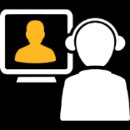
Introduction
Manorama Infosolutions has a ready solution for remote Tele-consulting to address the Corona-virus Pandemic situation. This solution can alleviate multiple risks:
Patient visit load is taken care by the Call Centre
Doctors / Hospital staff exposure to the virus will be reduced
Patients can have a video consulting from their homes, also reducing their exposure to the virus
Efficient usage of Clinical Resources (Doctors, Nurses & Infrastructure) and optimal care delivery for patients

Slide 3










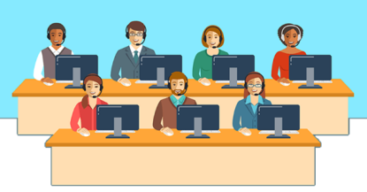
Introduction
Our Telemedicine & Consultation solution will be hosted on cloud or Hospital Premises or any Government authority needs to setup a Mini Epidemic Management Center (MEMC) with 2-4 computers having Internet Connectivity for Nurses or Medical Officers and Doctors and a few phone numbers or a toll free number.
On Cloud
On Premises
Setup a mini epidemic management center
Nurses, Doctors & Medical Officers

Slide 4





Workflow
Option 1: Any patient calls on a toll free number and provides all the demographic details and symptoms over the phone. The Nurse then registers a new patient in the Tele-Medicine Solution after which the Nurse can setup a virtual appointment slot with any doctor within the pool of doctors present at the remote consultation Hub.
+
Appointment
Patient
Demographic details & Symptoms
Nurse
Doctor

Slide 5






Workflow
Option 2: Any patient registers themselves using an online portal and fills in demographics details describing the symptoms in few words and requests for a virtual Tele-Consult appointment. A nurse will set an appointment for
the patient.
Patient
+
Appointment
Demographic details & Symptoms
Online Portal
Nurse
Doctor

Slide 6



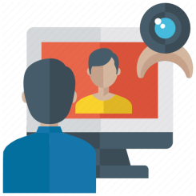




Workflow
The appointment slot, date and time is confirmed on the patient’s registered mobile number via an SMS. The SMS shall also provide a web link which allows the patient to launch an application to start audio video conversation with the Doctor through mobile or any web browser on a laptop or computer. At the time of appointment, patient clicks on the link and a video link is established with the Doctor on the other end. The doctor conducts the consultation, records the diagnosis and concludes the consultation.
A Proper guidance to the Patient
Via SMS
Appointment Slot
Date and Time
Weblink
Lab Test Recommendation and location of nearby test centre
Appointment Confirmation
Patient
Audio-Video Conversation
Doctor Consultation
Educational Content regarding the disease
To use this solution the hospital or authority will require hosting facility like a server and reasonable internet bandwidth to sustain the video consultation. Our Tele-Medicine & Consultation Solution offers Virtual Medical Clinic setup that help deliver remote patient care.

Slide 7

Thank You
www.manoramahealthcare.com
Head Office: Kolhapur
Branch Offices: Mumbai, Pune, Bangalore, Delhi
International Offices: Dubai, Singapore

